Slide 1



SQL STORED PROCEDURE
IN MySQL
By
Nidhi Sharma

Slide 2

Definition
COL 1
A stored procedure is a set of SQL statements that perform defined actions.
These procedures are stored and executed on the database server. u
Queries
COL 1 | COL 2 | COL 3
CREATE PROCEDURE `new_procedure` ()
BEGIN
END;
Stored Procedure
Data
This Photo by Unknown Author is licensed under CC BY-NC

Slide 3
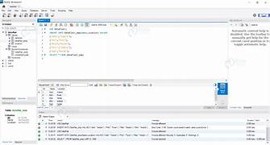
Key points of SQL Procedure
SQL Procedure
Code of reusability
Modular design
Performance Boost
Network Optimization
Enhanced security

Slide 4
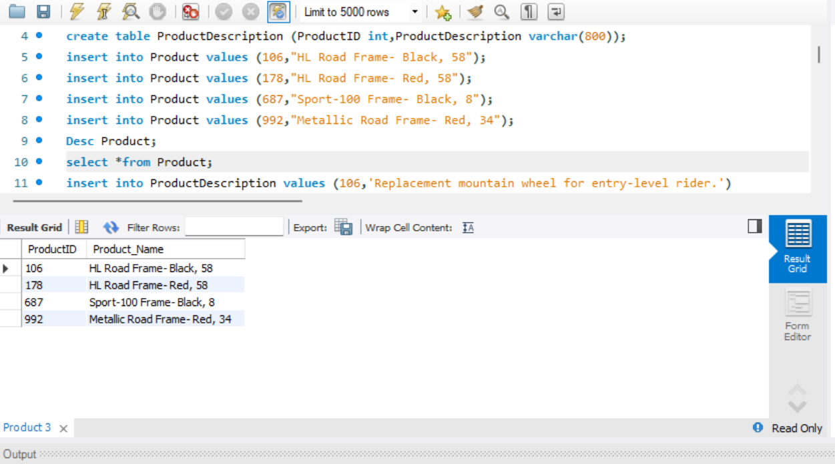
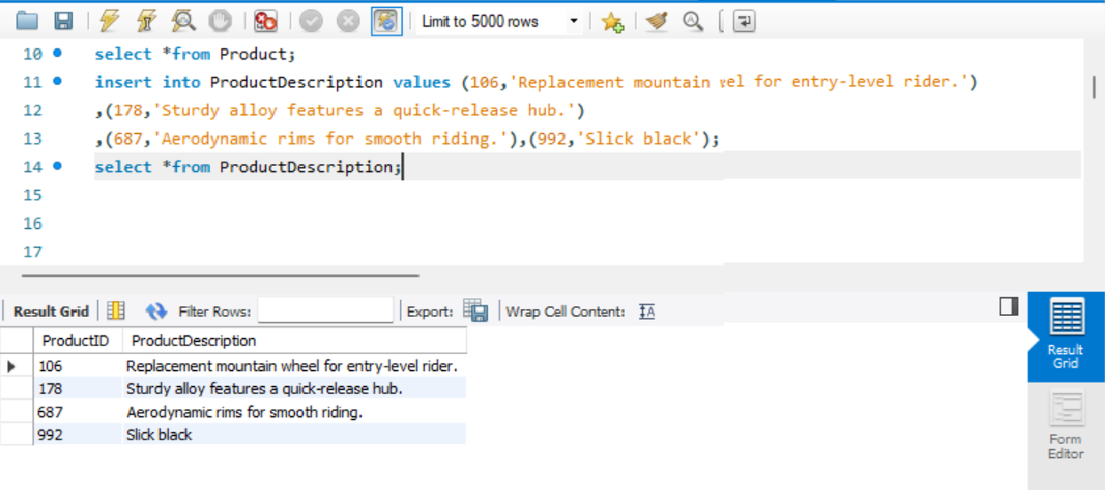
Syntax of creating a database and table
Create a Database and table

Slide 5
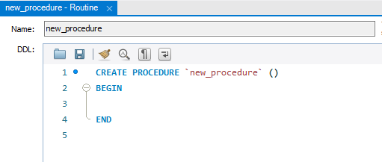
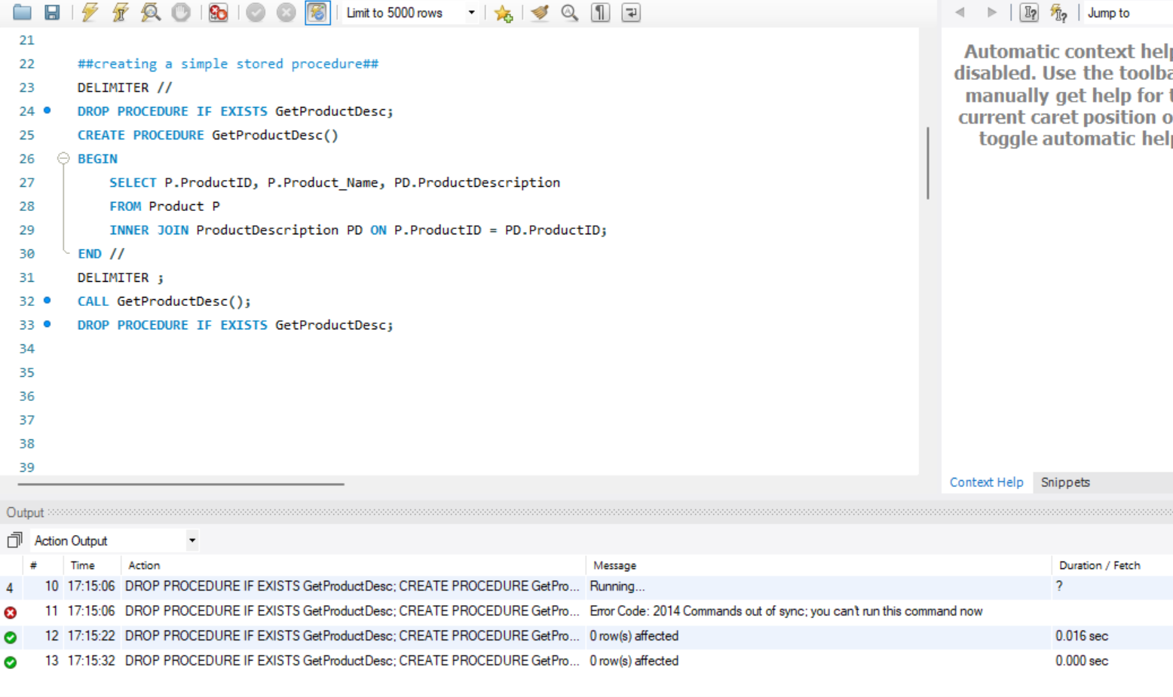
Syntax of creating Procedure
Create a stored Procedure
Types Parameters:
IN: Passes value to the procedure.
OUT: Returns value from the procedure.
INOUT: Passes and returns values.
2. Create a condition and execute the stored procedure

Slide 6
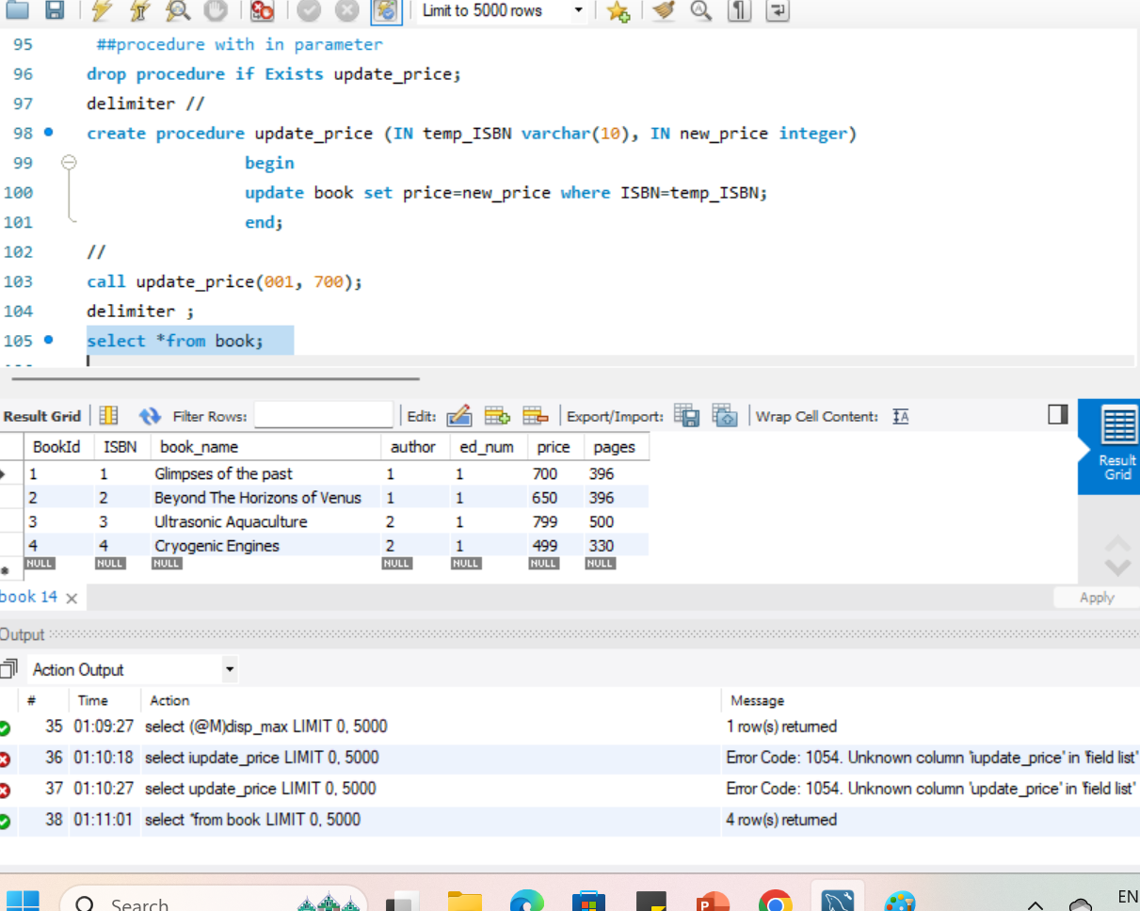
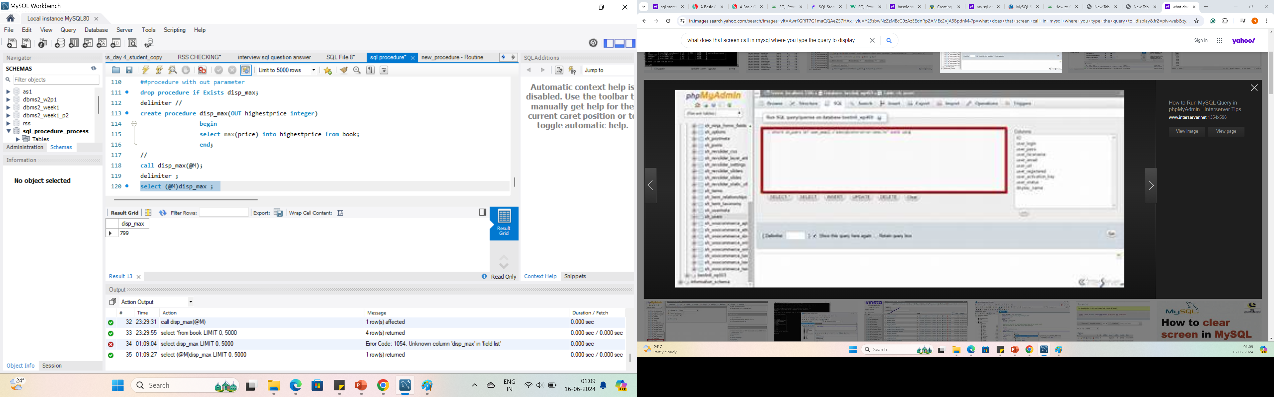
Syntax of creating Procedure with in and out Parameter
In Parameter
Out Parameter

Slide 7
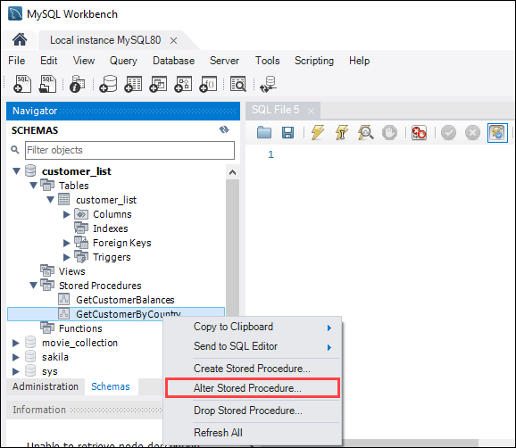
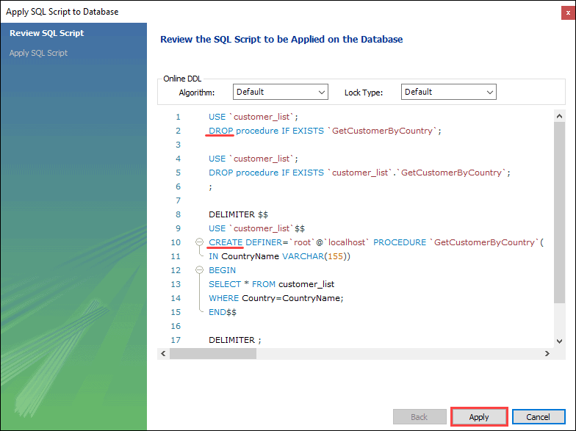
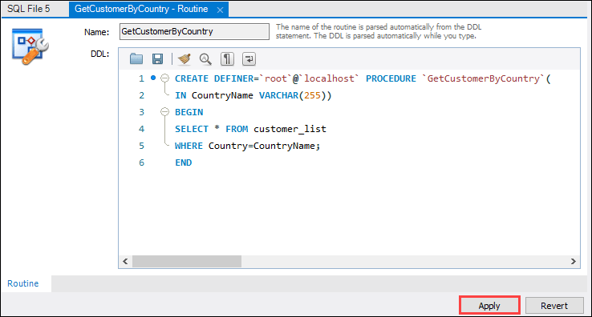
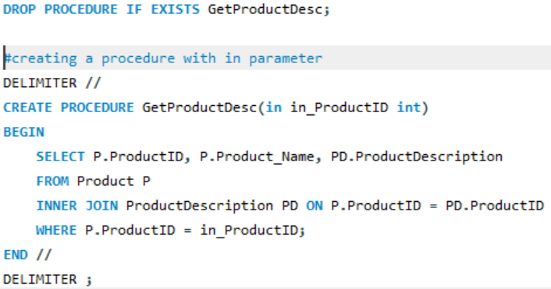
Syntax to modify procedure in MySQL
Steps to modify:
1. Select alter procedure from the navigator section
3. Click Apply and then Finish in the next window to execute the script.
2. Make the desired changes to the existing procedure and click on Apply button
Another alternative way is dropping the existing procedure and recreating the new SQL procedure.

Slide 8
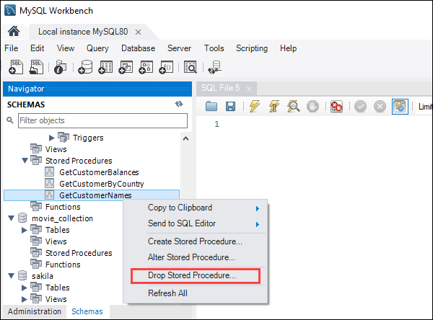
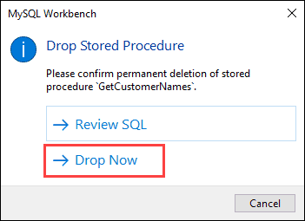
Syntax of dropping stored procedure
1. Right-click the stored procedure you want to delete and choose Drop Stored Procedure from Navigator section.
2. click Drop Now to delete the stored procedure.

Slide 9

Thank You

